Slide 1
BITI 2223 Machine learning project sales prediction machine
GROUP MEMBERS
NAME | MATRIC NO | SECTION/GROUP
ANG WEI KANG | B032110301 | BITI S1G2
SIM WENG JIN | B032110376 | BITI S1G2
LUM FU YUAN | B032110251 | BITI S1G2
TEH XIAO THONG | B032110141 | BITI S1G2

Slide 2
Project background
Advertisement (tv, social media, radio, influencer): one way to promote.
Company has limited budget on promoting.
Need to use budget in appropriately to get highest sales.
Spend lot of time and money if try one by one.
Need a machine which can make sales prediction based on different separation of budget.

Slide 3
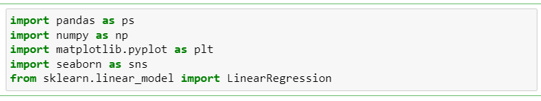
JUSTIFIABLE AND EXPLORATORY DATA ANALYSIS
Importing Libraries

Slide 4
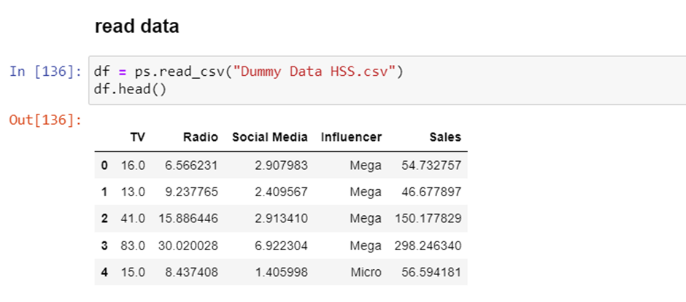
Read Data

Slide 5
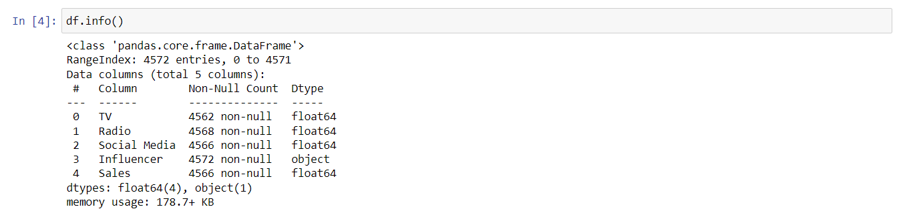
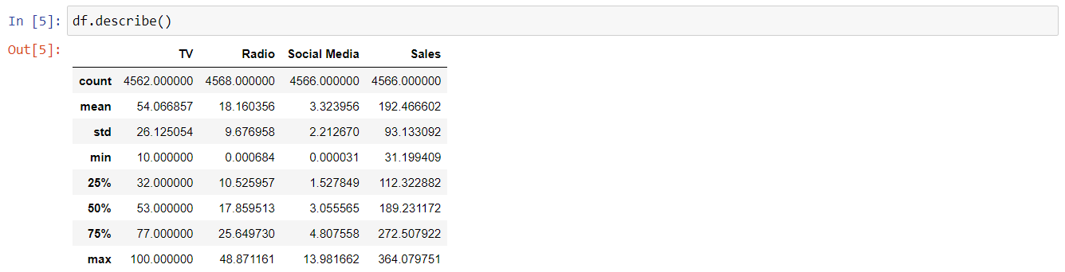
Data Understanding

Slide 6
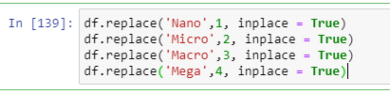

Data Convert

Slide 7
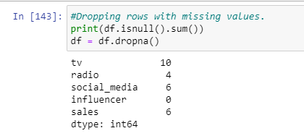
Data Cleaning

Slide 8
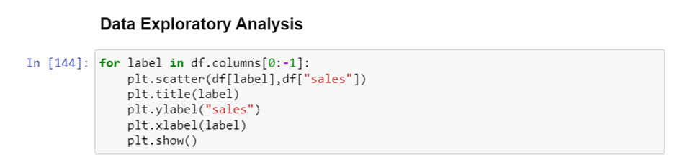
Data Exploratory Analysis

Slide 9
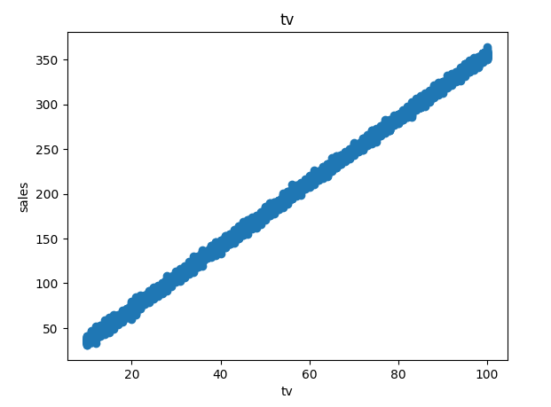
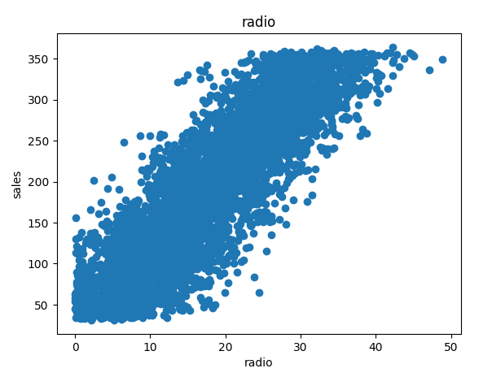
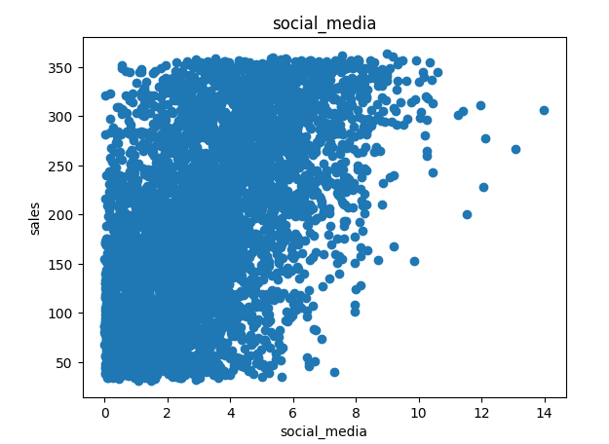
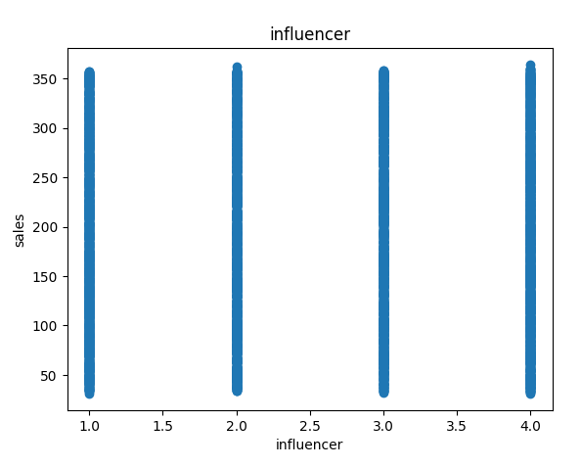
Data Exploratory Analysis

Slide 10
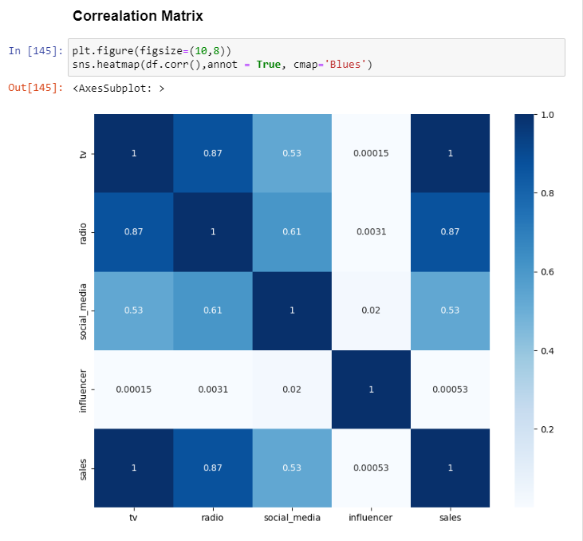
To investigate the relationship between sales and its variables

Slide 11
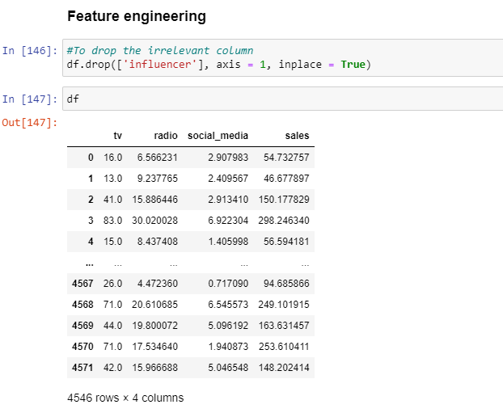
FEATURE ENGINEERING

Slide 12
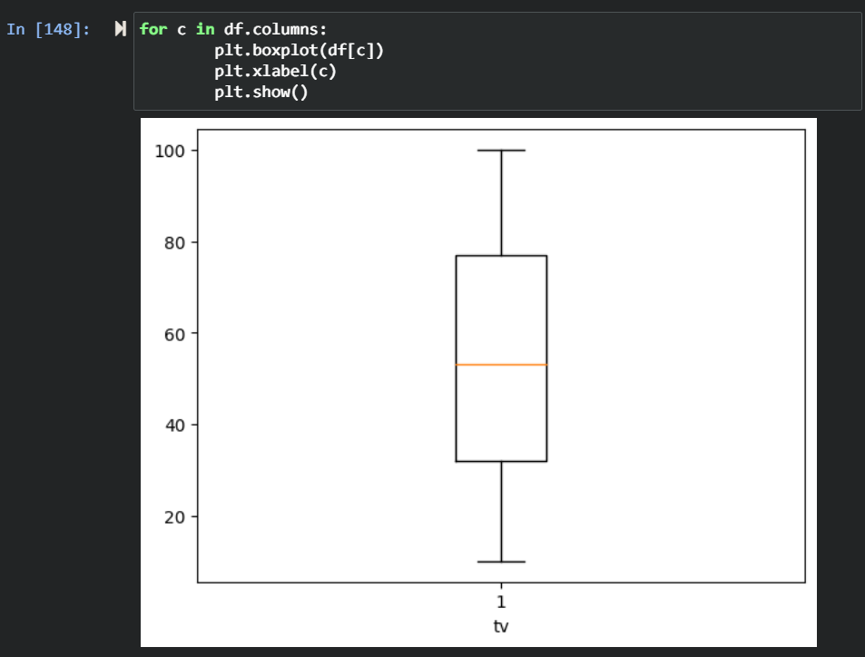
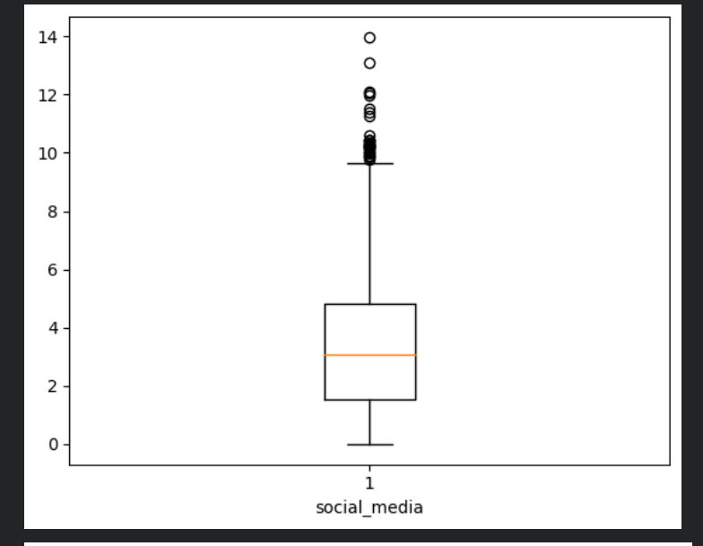
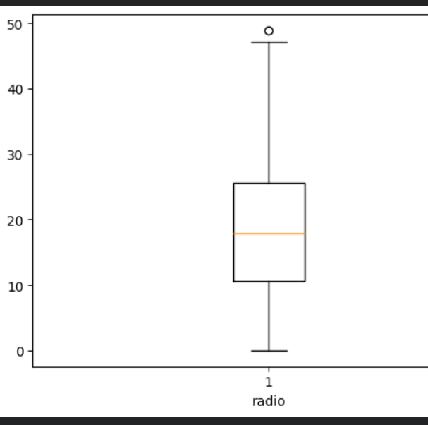
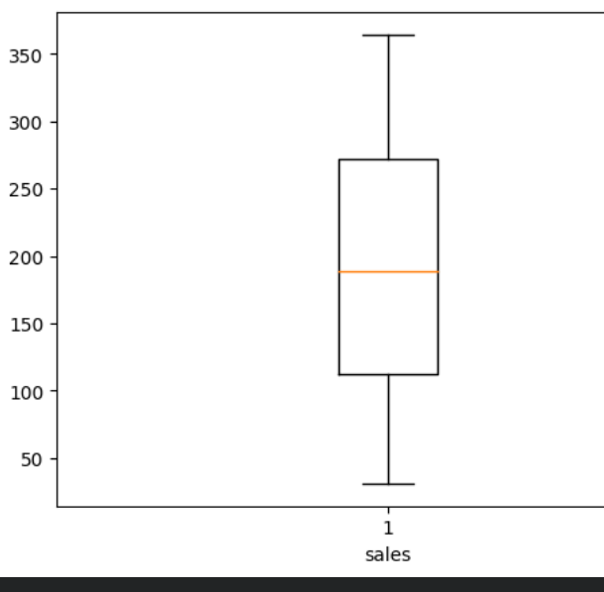
Detecting Outlier Visually

Slide 13
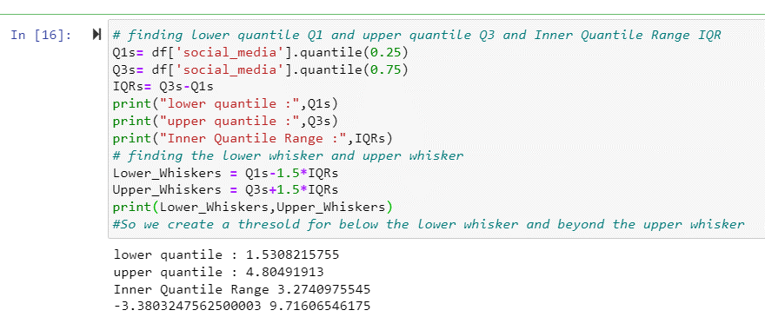
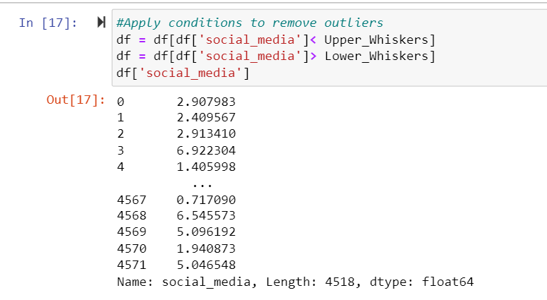
remove the outliers

Slide 14
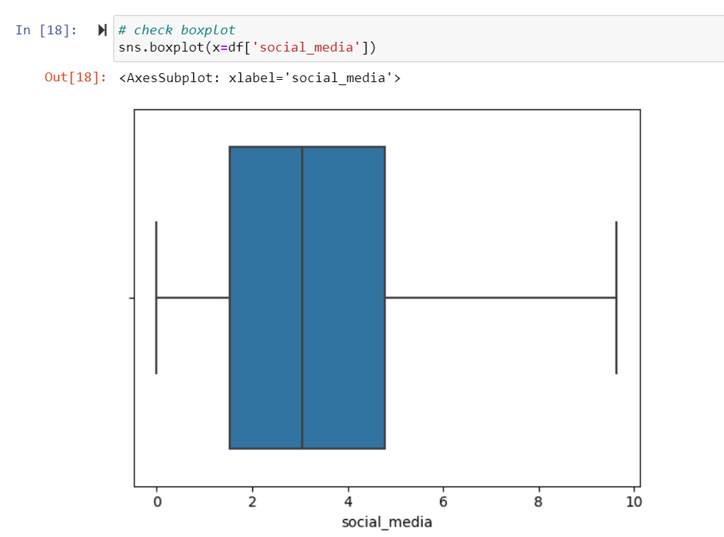
Check boxplot

Slide 15
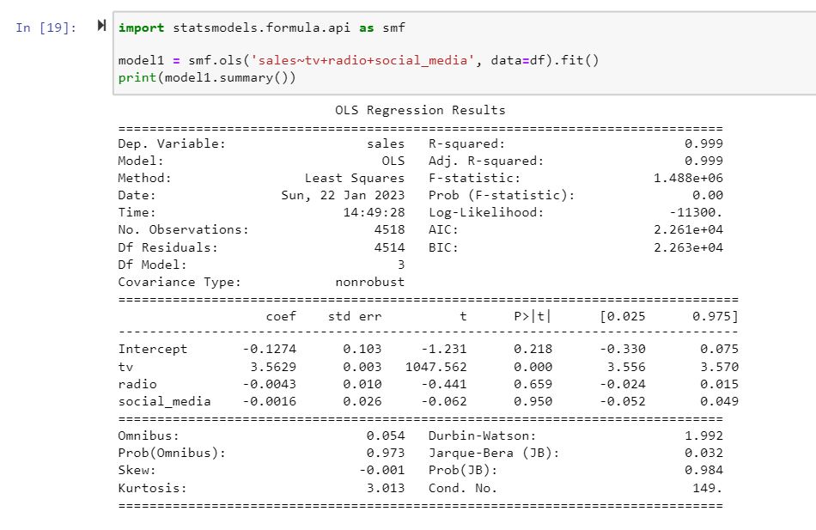
MACHINE LEARNING SOLUTION

Slide 16
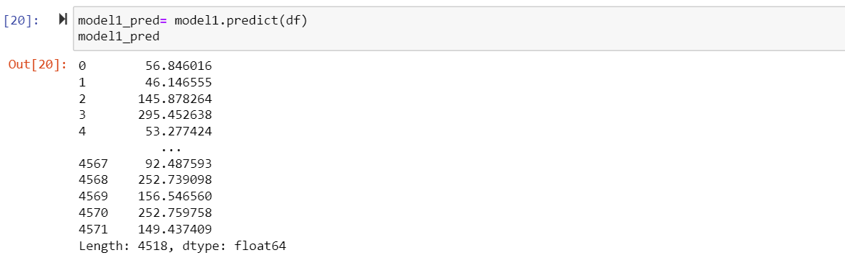
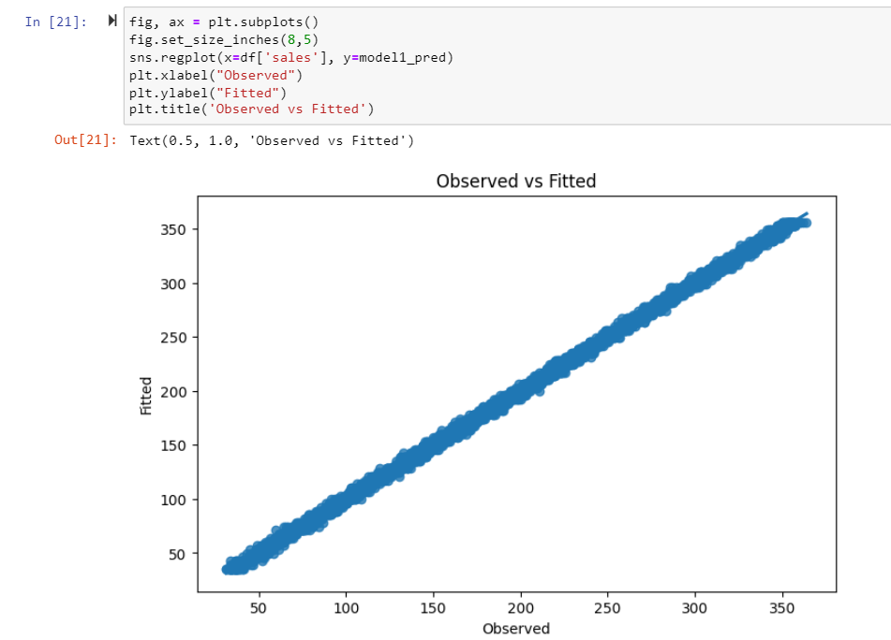

Slide 17
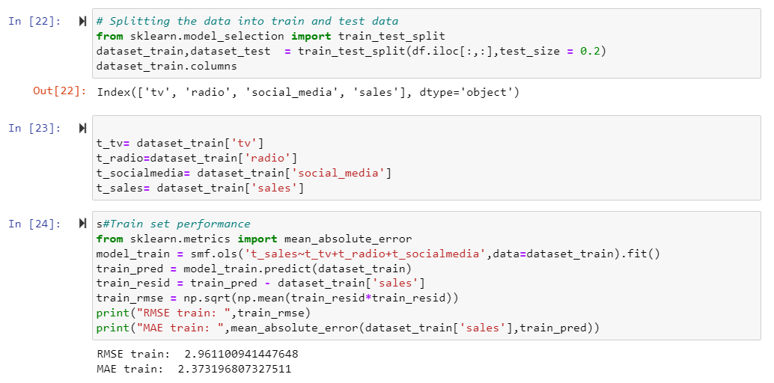
experimentation

Slide 18
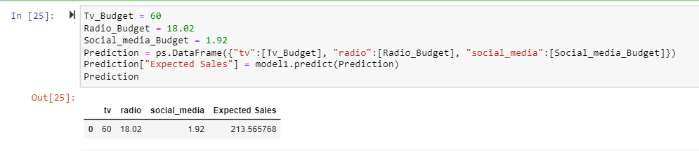
Result and discussion

Slide 19
conclusion
Requirement of company is fulfilled.
Objectives of this project are achieved.
The machine can learn to earn experience.
It can use the experience to make prediction.
It can be said to be a successful machine.

Slide 20
THANK YOU

